Slide 1
操作系统课程设计 Nachos (C)
山东大学计算机科学与技术学院
2018 秋

Slide 2
To Get Your Hands Dirty
Read and analyze
Build
Observe
The only way is
to have students read and experiment at the source code level

Slide 3
Content
1. Introduction
2. Nachos Machine
3. Nachos Threads
4. User level process
5 Nachos Filesystem

Slide 4
1. Introduction to Nachos
Nachos is a working operating system for teaching operating systems
About 9,500 lines of C++ code
Written by Prof. Tom Anderson from the University of California at Berkeley
It has been used by many universities in the world for teaching operating systems
The only difference between Nachos and a ``real'' operating system is that Nachos runs as a single Unix process, whereas real operating systems run on bare machines
Nachos Source Code
http://www.cs.washington.edu/homes/tom/nachos/

Slide 5
构造一个虚拟的程序运行环境
MIPS CPU
内存
中断机制
时钟
中断处理程序
系统调用
设备
磁盘
文件系统
Nachos
Nachos中既包含了虚拟机的实现，又包含了操作系统的实现
Nachos构造的虚拟机仅为运行用户程序
操作系统的运行可以基于MIPS虚拟机，但没必要！操作系统程序与Nachos虚拟机直接处于了同一层

Slide 6
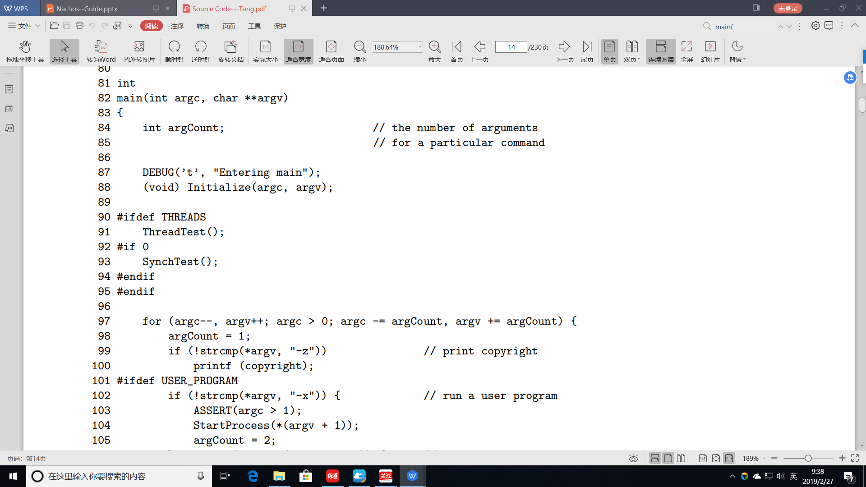
主程序
Initialize()
ThreadTest()
SynchTest()

Slide 7
2. Nachos Machine
2.0 Overview of Nachos Machine
2.1 Machine Components
2.2 Interrupt Management
2.3 Real-Time Clock Interrupts
2.4 Address Translation
2.5 Console Device
2.6 Disk Device

Slide 8
2.0 Overview of Nachos Machine
MIPS Simulator
Two Modes
Execute concurrently

Slide 9
MIPS Simulator
MIPS architecture
Registers, Memory, CPU, Clock
The simulated MIPS machine can execute arbitrary MIPS programs
Loads instructions into the machine's memory
Initializes registers，including the PC
Tells the machine to start executing instructions
The machine repeats indefinitely until an illegal operation
Fetches the instruction PCReg points at
Decodes it
Executes it
When a trap or interrupt takes place
ecution of MIPS instructions is suspended
a Nachos interrupt service routine is invoked

Slide 10
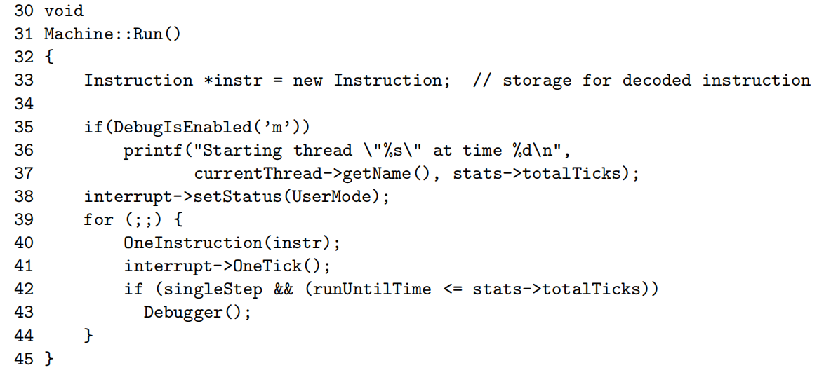
执行用户程序的流程

Slide 11
Two Modes
Two modes of program execution
User mode (MIPS simulator)
Kernel mode (MIPS simulator & Nachos kernel)
MIPS simulator
Loading them into the simulator memory
Initializing the simulator registers
Running the simulator to excute inatructions one by one
Nachos kernel
A normal process on the UBUNTU
Nachos first starts up
A hardware trap: illegal instruction, page fault or system call
Nachos kernel does't run at the MIPS machine, why?
User program
Nachos kernel
MIPS CPU
MIPS 内存
MIPS 设备
Operating System(UBUNTU)
HOST Machine

Slide 12
Execute Concurrently
A Nachos thread can implement a MIPS simulator
Nachos threads
Allowing multiple threads to execute concurrently
Nachos behaves in a manner analogous to other thread packages
UBUNTU: Nachos threads are user level threads
Each user process has a Nachos thread executing the MIPS simulator
User: Nachos threads are kernel level threads
Nachos supports user programs to execute concurrently
UBUNTU process, Nachos threads, user processes
Different user programs can be excuted concurrently

Slide 13
Execute Concurrently (cont.)
MIPS CPU can be multiplexed
Stock Nachos assumes only a single user program exists at a given time
Simply zeros out all of physical memory when creating a process
Any virtual address N can maps directly into the physical address N
CPU and memory is dedicated
Multiple user processes can have been added
AddrSpace::SaveUserState()
AddrSpace::RestoreUserState()

Slide 14
2. Nachos Machine
2.0 Overview
2.1 Machine Components
2.2 Interrupt Management
2.3 Real-Time Clock Interrupts
2.4 Address Translation
2.5 Console Device
2.6 Disk Device

Slide 15
2.1 Machine Components
Machine object
Implements the Nachos MIPS machine
An instance of Machine is created when Nachos first starts up
The Machine object provides
registers
physical memory
virtual memory support
operations to run the machine or examine its current state
仅用于执行用户进程
Global variable
machine

Slide 16
Registers
An array of registers
general purpose registers
a stack pointer
a double register for multiplication results
a program counter
next program counter (for branch delays)
a register target for delayed loads
a value to be loaded on a delayed
bad virtual address after a translation fault
The registers are number 0-39
symbolic names for the registers having special meaning
Accessing Registers
ReadRegister and WriteRegister
machine->registers[n]

Slide 17
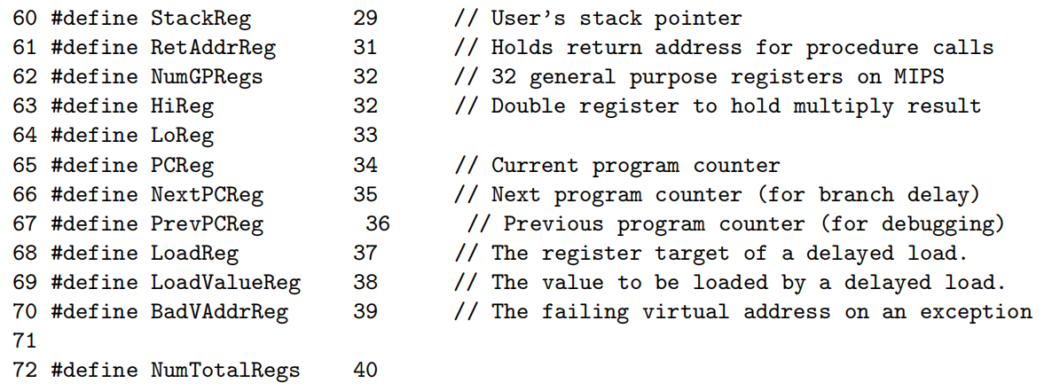
Registers--source code
158 int registers[NumTotalRegs]; // CPU registers, for executing user programs

Slide 18
Physical Memory
Memory is byte addressable and organized into 128-byte pages
Memory corresponding to physical address x can be accessed
machine->mainMemory[x]
Nachos MIPS machine has 31 pages of physical memory
31 #define PageSize SectorSize // set the page size equal to
32 // the disk sector size, for
33 // simplicity
34
35 #define NumPhysPages 32
36 #define MemorySize (NumPhysPages * PageSize)
156 char *mainMemory; // physical memory to store user program

Slide 19
Virtual Memory
Nachos supports VM
Either a single linear page table
Or a software managed TLB (though not simultaneously) is controlled by initializing the tlb or pageTable variables of the machine class
When executing instructions, the Machine object uses whichever is defined，after verifying that they are not both set simultaneously
37 #define TLBSize 4 // if there is a TLB, make it small
179 TranslationEntry *tlb; // this pointer should be considered
180 // "read-only" to Nachos kernel code
181
182 TranslationEntry *pageTable;
183 unsigned int pageTableSize;

Slide 20
How to Executes a User Program
First, we load the program into the machine's physical memory
e.g,the machine->mainMemory variable_x0002_
Next, we initialize the machine's page tables and registers
Create virtual address space
Finally we invoke machine->Run() which begins the fetch-execute cycle for the machine

Slide 21
machine.h
107 class Machine {
108 public:
109 Machine(bool debug); // Initialize the simulation of the hardware
110 // for running user programs
111 ~Machine(); // De-allocate the data structures
112
113 // Routines callable by the Nachos kernel
114 void Run(); // Run a user program
115
116 int ReadRegister(int num); // read the contents of a CPU register
117
118 void WriteRegister(int num, int value);
119 // store a value into a CPU register
120

Slide 22
machine.h
121
122 // Routines internal to the machine simulation -- DO NOT call these
123
124 void OneInstruction(Instruction *instr);
125 // Run one instruction of a user program.
126 void DelayedLoad(int nextReg, int nextVal); // 每执行完一条指令都做，模拟指令执行时的延迟加载
127 // Do a pending delayed load (modifying a reg)
128
129 bool ReadMem(int addr, int size, int* value);
130 bool WriteMem(int addr, int size, int value);
131 // Read or write 1, 2, or 4 bytes of virtual
132 // memory (at addr). Return FALSE if a
133 // correct translation couldn’t be found.
134

Slide 23
machine.h
135 ExceptionType Translate(int virtAddr, int* physAddr, int size,bool writing);
136 // Translate an address, and check for
137 // alignment. Set the use and dirty bits in
138 // the translation entry appropriately,
139 // and return an exception code if the
140 // translation couldn’t be completed.
141
142 void RaiseException(ExceptionType which, int badVAddr);
143 // Trap to the Nachos kernel, because of a
144 // system call or other exception.
145
146 void Debugger(); // invoke the user program debugger
147 void DumpState(); // print the user CPU and memory state
148

Slide 24
machine.h
149
150 // Data structures -- all of these are accessible to Nachos kernel code.
151 // "public" for convenience.
152 //
153 // Note that *all* communication between the user program and the kernel
154 // are in terms of these data structures.
155
156 char *mainMemory; // physical memory to store user program,
157 // code and data, while executing
158 int registers[NumTotalRegs]; // CPU registers, for executing user programs
159
160
161 // NOTE: the hardware translation of virtual addresses in the user program
162 // to physical addresses (relative to the beginning of "mainMemory")

Slide 25
machine.h (cont.)
163 // can be controlled by one of:
164 // a traditional linear page table
165 // a software-loaded translation lookaside buffer (TLB) -- a cache of
166 // mappings of virtual page #’s to physical page #’s
103
167 //
168 // If "tlb" is NULL, the linear page table is used
169 // If "tlb" is non-NULL, the Nachos kernel is responsible for managing
170 // the contents of the TLB. But the kernel can use any data structure
171 // it wants (eg, segmented paging) for handling TLB cache misses.
172 //
173 // For simplicity, both the page table pointer and the TLB pointer are
174 // public. However, while there can be multiple page tables (one per address
175 // space, stored in memory), there is only one TLB (implemented in hardware).

Slide 26
machine.h (cont.)
176 // Thus the TLB pointer should be considered as *read-only*, although
177 // the contents of the TLB are free to be modified by the kernel software.
178
179 TranslationEntry *tlb; // this pointer should be considered
180 // "read-only" to Nachos kernel code
181
182 TranslationEntry *pageTable;
183 unsigned int pageTableSize;
184
185 private:
186 bool singleStep; // drop back into the debugger after each
187 // simulated instruction
188 int runUntilTime; // drop back into the debugger when simulated
189 // time reaches this value

Slide 27
machine.h (cont.)
190 };
191
192 extern void ExceptionHandler(ExceptionType which);
193 // Entry point into Nachos for handling
194 // user system calls and exceptions
195 // Defined in exception.cc
196
197
198 // Routines for converting Words and Short Words to and from the
199 // simulated machine’s format of little endian. If the host machine
200 // is little endian (DEC and Intel), these end up being NOPs.
201 //
202 // What is stored in each format:
203 // host byte ordering:

Slide 28
machine.h (cont.)
204 // kernel data structures
205 // user registers
206 // simulated machine byte ordering:
207 // contents of main memory
208
209 unsigned int WordToHost(unsigned int word);
210 unsigned short ShortToHost(unsigned short shortword);
211 unsigned int WordToMachine(unsigned int word);
212 unsigned short ShortToMachine(unsigned short shortword);
213
214 #endif // MACHINE_H

Slide 29
2. Nachos Machine
2.0 Overview
2.1 Machine Components
2.2 Interrupt Management
2.3 Real-Time Clock Interrupts
2.4 Address Translation
2.5 Console Device
2.6 Disk Device

Slide 30
2.2 Interrupt Management
Nachos simulates interrupts by maintaining
An event queue
A simulated clock
As the clock ticks, the event queue is examined to find events to be scheduled
The clock is maintained entirely in software
The clock is maintained entirely in software and ticks under the following conditions
Every time interrupts are restored, the clock advances one tick
Whenever MIPS simulator executes one instruction, the clock advances one tick
Whenever the ready list is empty, the clock advances however many ticks are needed to fast forward the current time to that of the next scheduled event
Whenever the clock advances, the event queue is examined and any pending interrupt events are serviced by invoking the associated procedure

Slide 31
Warning: Deadlock
All interrupt service routines are run with interrupts disabled and the interrupt service routine may not re-enable them
In interrupt handler, may not call any routines that lead to a context switch
Doing so may lead to deadlock
This restriction is an artifact of the way interrupts are simulated under Nachos, not on real machines
e.g., Multiple events happen at exactly the same time
When the handler for the first event invokes sleep, disenable the interrupt
In fact, the thread that called sleep may actually be waiting for one of the other events that is supposed to take place now
==>deadlock
To correctly implement preemption, Sleep==>YieldOnReturn
Delays the actual preemption until it is safe to do so

Slide 32
Interrupt Object
void Schedule(VoidFunctionPtr handler, int arg, int when, IntType type)
Schedules a future event to take place at time when
When it is time for the scheduled event to take place, Nachos calls the routine handler with the single argument arg, p99
IntStatus SetLevel(IntStatus level), p99
Change the interrupt mask to level, returning the previous value
This routine is used to temporarily disable and re-enable interrupts for mutual exclusion purposes
Only two interrupt levels are supported: IntOn and IntOff
OneTick()
Advances the clock one tick and services any pending requests
It is called from machine::Run() after each user-evel instruction is executed as well as by SetLevel when the interrupts are restored

Slide 33
Interrupt Object (cont.)
bool CheckIfDue(bool advanceClock), p99
Examines the event queue for events that need servicing now
If it finds any, services them
It is invoked in OneTick() or Idel()
Idle(), p98
“Advances” to the clock to the time of the next scheduled event
It is called by the scheduler(actually Sleep) when there are no more threads on the ready list
We want to “fast-forward” the time
If there are no pending interrupts, stop Nachos. why?
void Interrupt::Halt(), p98
Nachos全部退出

Slide 34
2. Nachos Machine
2.0 Overview
2.1 Machine Components
2.2 Interrupt Management
2.3 Real-Time Clock Interrupts
2.4 Address Translation
2.5 Console Device
2.6 Disk Device

Slide 35
2.3 Real-Time Clock Interrupts
Nachos provides a Timer object that simulates a real time clock generating interrupts at regular intervals
Timer supports the following operations
Timer(Void FunctionPtr timerHandler, int callArg, bool doRandom)
The Timer constructor creates a real time clock that interrupts every TimerTicks(100) time units
When the timer goes off, the Nachos simulator invokes procedure timerHandler, passing it callArg as an argument
To add a bit of non-determinism to the system, argument doRandom specifes that the time between interrupts
The real-time clock can be used to provide preemption

Slide 36
Real-Time Clock Interrupts (cont.)
Starting Nachos with the -rs option creates a timer object that interrupts at random intervals and preempts the currently running thread
void Timer::TimerExpired()
Routine to simulate the interrupt generated by the hardware timer device
Schedule the next interrupt
Invoke the interrupt handler
注意Timer interrut和Clock tick的区别与联系

Slide 37

中断源，中断机制，中断处理
class of Interrupt
...
IntStatus level;
List *pending;
......
bool CheckIfDue(...);
void OneTick();
...
the list of interrupts scheduled

Slide 38
2. Nachos Machine
2.0 Overview
2.1 Machine Components
2.2 Interrupt Management
2.3 Real-Time Clock Interrupts
2.4 Address Translation
2.5 Console Device
2.6 Disk Device

Slide 39
2.4 Address Translation
Nachos supports two types of VM architectures
linear page tables
or a software managed TLB
Physical address
the MMU splits a virtual address into page number and page offset
The page number is used to index into an array of page table entries
The actual physical address is the concatenation of the page frame numberthe page offset
Each user process will have its own private page table
A process switch requires updating the pageTable variable(pointing the page table)
In a real machine pageTable would correspond to a special register that would be saved and restored as part of the SWITCH operation

Slide 40
Page Table Entries
Page frame number
For the corresponding virtual page
Valid flag indicating whether the entry is currently valid
Set by OS, inspected by hardware
Write-Protection flag indicating whether the page may be written
set by OS, inspected by hardware
A bit indicating whether the page has been referenced
set by the hardware, inspected and cleared by OS
A dirty bit
set by hardwareinspected and cleared by OS
The Nachos machine has NumPhysPages of physical memory
Page 0 starts at machine->mainMemory
Page N starts at mainMemory+NxPageSize

Slide 41
2. Nachos Machine
2.0 Overview
2.1 Machine Components
2.2 Interrupt Management
2.3 Real-Time Clock Interrupts
2.4 Address Translation
2.5 Console Device
2.6 Disk Device

Slide 42
2.5 Console Device
Nachos devices are accessed
Through low-level primitives that simply initiate an I/O operation
The operation itself is performed later
With an operation complete interrupt notifying Nachos
The Console class simulates CRT device
Data can be written to CRT one character at a time through the PutChar()
When a character has successfully been transmitted, a interrupt takes place
The user-supplied handler is invoked
The interrupt handler presumably checks if more characters are waiting to be output,invoking PutChar again if appropriate
The Console class simulates Keyboard device
Input characters arrive one at a time
When a new character arrives the console device generates an interrupt
The service routine is invoked to retrieve the character from the device and place it into a buffer
From the buffer, GetChar() can retrieve it later

Slide 43
Console Object
Console(char readFile, char writeFile, VoidFunctionPtr readAvail, VoidFunctionPtr writeDone, int callArg)
void PutChar(char ch)
char GetChar()
void CheckCharAvail()

Slide 44
Console Input
When a console device is created
The appropriate Unix files(or stdin, stdout) are opened
A timer event is scheduled to take place 100 time units in the future
When the timer expires
The routine CheckCharAvail is invoked to see if any data is present
If so, CheckCharAvail reads that character and invokes readAvail
It then schedules a new timer event 100 time units later
Thus CheckCharAvail simply polls every 100 clock ticks for new data，calling the interrupt service routine whenever data is present for processing

Slide 45
Console Output
Device output is initiated by calling PutChar Giving it one character to output
Once character output has been initiated
The device is made busy until the output complete
Interrupt takes place
PutChar simply outputs the one character
Sets an internal flag to indicate that the device is busy
And then schedules a timer interrupt to take place 100 clock ticks later
When the timer expires
The state of the device is changed from busy to idle
The output interrupt complete routine is invoked
Invoke PutChar if additional output characters were queued awaiting output

Slide 46
2. Nachos Machine
2.0 Overview
2.1 Machine Components
2.2 Interrupt Management
2.3 Real-Time Clock Interrupts
2.4 Address Translation
2.5 Console Device
2.6 Disk Device

Slide 47
2.6 Disk Device
Disk
Only a single platter， NumTracks(32) tracks
Each track contains SectorsPerTrack(32) sectors
Each sector is SectorSize(128) in size
Blocks are uniquely identied by their sector number
A “track buffer” cache
Disk I/O
The OS initiates operations to read or write a specific sector
A later interrupt indicates when the operation has actually completed
Note that
The Nachos disk allows only one pending operation at a time, the OS may initiate new operations only when the device is idle
it is the responsibility of the OS to insure that new requests are not issued while the disk is busy servicing an earlier request

Slide 48
Like a Real Disk
In order to simulate typical delays in accessing a disk, the Nachos Disk object dynamically varies the time
The initiation of an I/O operation
Its corresponding I/O complete interrupt
The actual delay depends on
The time to move the disk head from its previous location to the new track
The rotational delay encountered waiting for the desired block

Slide 49
Disk Object
Disk(char name, VoidFunctionPtr callWhenDone, int callArg)
The simulated disk is kept in a file called name
magic number 0x456789ab
the rest of the file contains NULL sectors
The last two arguments are used to provide an I/O complete interrupt
The Nachos machine signals the completion by invoking the callWhenDone
Passing it an argument of callArg
ReadRequest(int sectorNumber, char data)
To read the specified sector number into the buffer data
This operations returns immediately before the transfer takes place
ReadRequest schedules an interrupt to take place in the future
Only after the interrupt takes place is it correct to use the data

Slide 50
Disk Object (cont.)
WriteRequest(int sectorNumber, char data)
Similar to ReadRequest
ComputeLatency(int newSector, bool writing)
Estimates the latency required to access the block newSector given the current position of the disk head
The routine is used in deciding when to schedule an I/O complete interrupt when servicing a read or write request

Slide 51
Content
1. Introduction
2. Nachos Machine
3. Nachos Threads
4. User level process
5. Nachos Filesystem
6. Experience With Nachos Assignments

Slide 52
3. Nachos Threads
3.0 Basic concepts
3.1 Mechanics of Thread Switching
3.2 Threads & Scheduling
3.3 Synchronization and Mutual Exclusion
3.4 Special Notes
3.5 Controlling the Order of Execution in Nachos

Slide 53
3.0 Basic Concepts
Processes and Threads
User-level Threads and Kernel-level Threads
Nachos中的进程与线程
Nachos Threads

Slide 54
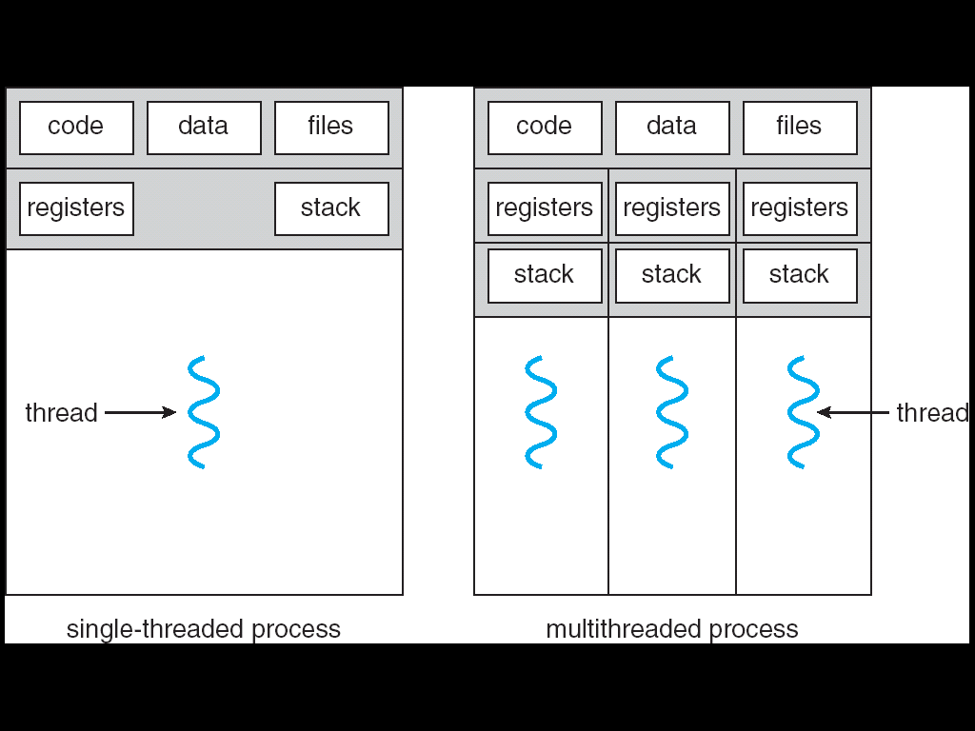
Processes and Threads

Slide 55
User-level Threads and Kernel-level Threads
User-level Threads
Managed by user-level threads library
POSIX Pthreads
Win32 threads
Java threads
Nachos threads
操作系统不知情
Kernel-level Threads
Supported by the Kernel
For examples
Windows XP,...10
Linux
Mac OS

Slide 56
Nachos中的进程与线程
Nachos 是UBUNTU中的一个普通进程
Nachos可以做的事情
创建或撤销用户级线程，多个用户级线程之间可以并发执行
Nachos实现线程之间的调度和切换
Nachos实现线程之间的同步
用户级线程与虚拟机
Nachos构建一个基于MIPS架构的Machine虚拟机
在这个虚拟机上还可以执行多个用户进程
但是目前的Nachos并没有提供在MIPS上的并发执行
在这个虚拟机上可以执行一个COFF格式的MIPS程序
这个程序可以由gcc从C程序编译生成
这个程序的执行称为虚拟机上的一个用户进程
Nachos为这个虚拟机提供中断处理和系统调用服务

Slide 57
Nachos Threads
Thread status
JUST_CREATED
RUNNING
READY
BLOCKED
Thread object
Thread::Thread(char debugName)
Fork(VoidFunctionPtr func, int arg)
void StackAllocate(VoidFunctionPtr func, int arg)
void Yield()
void Sleep()
void Finish()

Slide 58
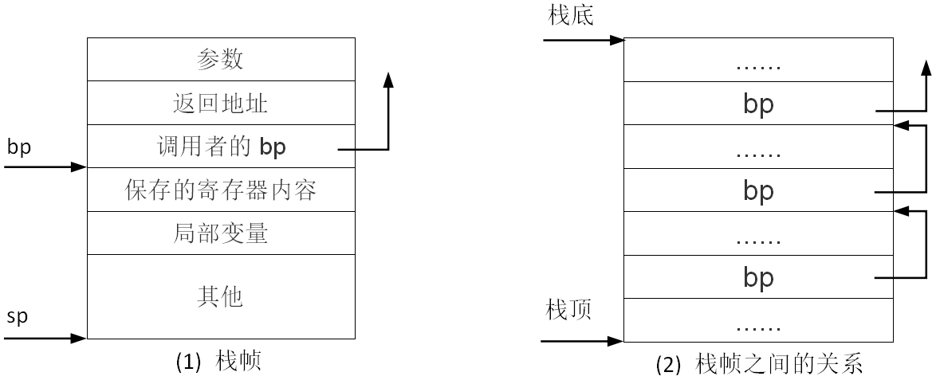
子程序调用--栈帧

Slide 59
子程序调用--栈操作流程
主程序
参数入栈（修改SP）
CALL 指令
返回地址入栈（修改SP）
跳转到子程序
子程序
保存主程序的栈帧指针寄存器BP【也可以在主程序中做】
设置子程序的栈帧指针寄存器BP（修改BP）【也可以在主程序中做】
保护主程序的寄存器值【可选】
分配局部变量【可选】
其他【可选】

Slide 60
Fork(VoidFunctionPtr func, int arg)
功能
Thread creation(构造函数建立结构，Fork()填充结构)
分配并初始化运行栈
放入就绪队列
Turning a thread into one that the CPU can schedule and execute
Arguments
The address of a procedure where the thread starts executing
'arg' should be passed to the new thread.The procedure func must expect a single argument to be passed to it
Allocates stack space for the new thread
initializes the registers, stack
void StackAllocate(VoidFunctionPtr func, int arg)
The procedure func returns
Since func was not called as a regular procedure call, there is no place for it to return to
The thread running func should terminate
source code p42

Slide 61
void StackAllocate(VoidFunctionPtr func, int arg)
Allocate memory for the stack (StackSize), 建立第一个栈帧
stack = (int *) AllocBoundedArray(StackSize * sizeof(_int));
Place a sentinel value at the top of the allocated stack
*stack = STACK_FENCEPOST
在栈中存放ThreadRoot的入口地址
*(--stackTop) = (int)ThreadRoot; // ThreadRoot 是进入线程前执行的程序
设置栈顶指针
stackTop = stack + StackSize - 4; // -4 to be on the safe side!
初始化寄存器数组
machineState[PCState] = (_int)ThreadRoot; // 好像没用
machineState[StartupPCState] = (_int)InterruptEnable;
machineState[InitialPCState] = (_int)func;
machineState[InitialArgState] = arg;
machineState[WhenDonePCState] = (_int)ThreadFinish;
source code p45

Slide 62
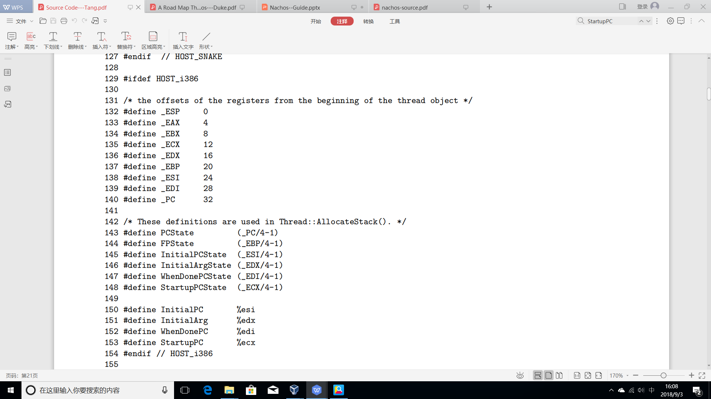
访问不同架构的CPU寄存器
注意，是从thread object开始的偏移量，非MacineState
全部寄存器在machineState[]中的地址，寄存器32位
运行数据在machineState[]中的地址
存放运行数据的寄存器的名称

Slide 63
线程对象内存结构
IA寄存器 | C程序宏名称 | 内容
ESP |  | 栈指针
EAX
EBX
ECX | StartupPCState | InterruptEnable()
EDX | InitialArgState | arg
EBP
ESI | InitialPCState | func()
EDI
PC | PCState | ThreadRoot()
stackTop
machineState
 | 栈
stack+StackSize-4
stack+StackSize-8 | ThreadRoot()
stack

Slide 64
ThreadRoot
ThreadRoot
Calls an initialization routine that simply enables interrupts
Calls the user-supplied function passing it the supplied argument
Calls thread::Finish() to terminate the thread
Is written in assembly language (source code p18)
Why ThreadRoot
Makes it straightforward to terminate the thread when it finishes
ThreadRoot isn't run by the thread that calls Fork()
The newly created thread executes the ThreadRoot when it is scheduled and starts execution
仅在首次进入时执行，以后再切换入线程，不再执行ThreadRoot
source code p22

Slide 65
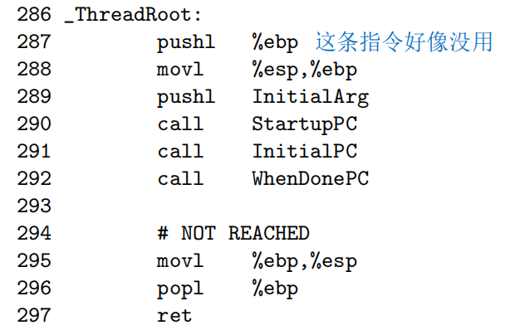
ThreadRoot源码

Slide 66
3. Nachos Threads
3.0 Basic concepts
3.1 Mechanics of Thread Switching
3.2 Threads & Scheduling
3.3 Synchronization and Mutual Exclusion
3.4 Special Notes
3.5 Controlling the Order of Execution in Nachos

Slide 67
3.1 Mechanics of Thread Switching
Switching the CPU from one thread to another involves
Suspending the current thread
Saving its state(e.g., registers)
Restoring the state of the thread being switched to
The thread switch actually completes at the moment
A new program counter is loaded into PC
At that point, the CPU is no longer executing the thread, but the new thread
The routine Switch(oldThread, nextThread) actually performs a thread switch
Switch saves all of oldThread's state
oldThread is the thread that is executing when Switch is called
It can resume executing the thread later, without the thread knowing it was suspended
Switch() is written in assembly language

Slide 68
What Does Switch Do?
Save all registers in oldThread's context block
What address should we save for the PC?
When we later resume running the thread, where do we want it to continue execution
Just like a normal procedure call
Resume execution at the instruction following the call to Switch
The return address found on the stack in the thread's activation record
Load new values into the registers(including PC) from the next thread
At what exact point has a context switch taken place?
The current PC is replaced by the saved PC found in the process table

Slide 69
SWITCH( thread *t1, thread *t2 )
301 /* void SWITCH( thread *t1, thread *t2 )
302 **
303 ** on entry, stack looks like this:
304 ** 8(esp) -> thread *t2
305 ** 4(esp) -> thread *t1
306 ** (esp) -> return address
307 **
308 ** we push the current eax on the stack so that we can use it as
309 ** a pointer to t1, this decrements esp by 4, so when we use it
310 ** to reference stuff on the stack, we add 4 to the offset.
311 */
312 .comm _eax_save,4
313
314 .globl _SWITCH

Slide 70
SWITCH( thread *t1, thread *t2 ) (1)
315 _SWITCH:
316 movl %eax,_eax_save # save the value of eax
317 movl 4(%esp),%eax # move pointer to t1 into eax
318 movl %ebx,_EBX(%eax) # save registers
319 movl %ecx,_ECX(%eax)
320 movl %edx,_EDX(%eax)
321 movl %esi,_ESI(%eax)
322 movl %edi,_EDI(%eax)
323 movl %ebp,_EBP(%eax) # 主程序的ebp，SWITCH没有自己的栈帧
324 movl %esp,_ESP(%eax) # save stack pointer
325 movl _eax_save,%ebx # get the saved value of eax
326 movl %ebx,_EAX(%eax) # store it
327 movl 0(%esp),%ebx # get return address from stack into ebx
328 movl %ebx,_PC(%eax) # save it into the pc storage
329

Slide 71
SWITCH( thread *t1, thread *t2 ) (2)
330 movl 8(%esp),%eax # move pointer to t2 into eax
331
332 movl _EAX(%eax),%ebx # get new value for eax into ebx
333 movl %ebx,_eax_save # save it
334 movl _EBX(%eax),%ebx # retore old registers
335 movl _ECX(%eax),%ecx
336 movl _EDX(%eax),%edx
337 movl _ESI(%eax),%esi
338 movl _EDI(%eax),%edi
339 movl _EBP(%eax),%ebp
340 movl _ESP(%eax),%esp # restore stack pointer
341 movl _PC(%eax),%eax # restore return address into eax
342 movl %eax,4(%esp) # copy over the ret address on the stack
343 movl _eax_save,%eax
344
345 ret # 利用栈中的返回地址进入新线程

Slide 72
3. Nachos Threads
3.0 Basic concepts
3.1 Mechanics of Thread Switching
3.2 Threads & Scheduling
3.3 Synchronization and Mutual Exclusion
3.4 Special Notes

Slide 73
3.2 Threads & Scheduling
The scheduler decides which thread to run next
The scheduler is invoked
Current thread wishes to give up the CPU
For example, the current thread may have initiated an I/O operation and must wait for it to complete before executing further
Nachos may preempt the current thread to prevent one thread from monopolizing the CPU
The Nachos scheduling policy is simple
Threads reside on a single unprioritized ready list
Threads are selected in a round-robin fashion

Slide 74
Scheduler Object
void ReadyToRun(Thread thread)
Thread FindNextToRun()
void Run(Thread nextThread)
Do the dirty work of suspending the current thread and switching to the new one
Note that it is the currently running thread that calls Run(). preeption?
A thread calls this routine when it no longer wishes to execute
Run() does the following
Check to see if the current thread overflowed its stack
Change the state of newly selected thread to RUNNING
Actually switch to the next thread by invoking Switch()
If the previous thread is terminating itself, kill it now after Switch()

Slide 75
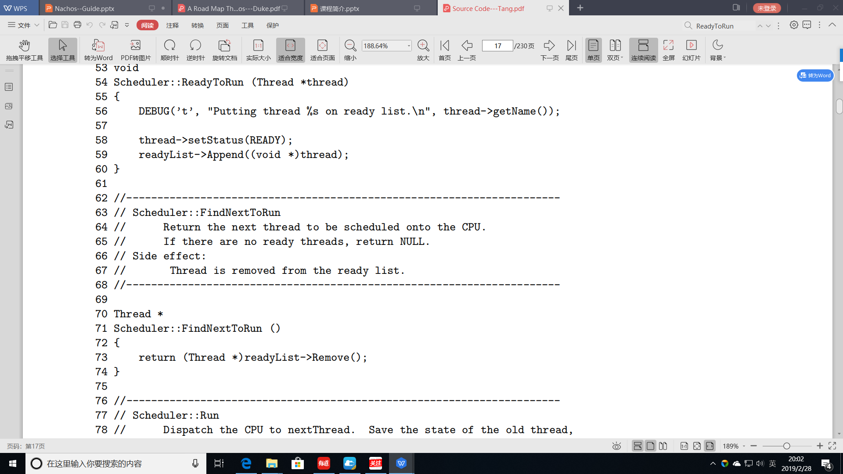
ReadyToRun() and FindNextToRun()

Slide 76
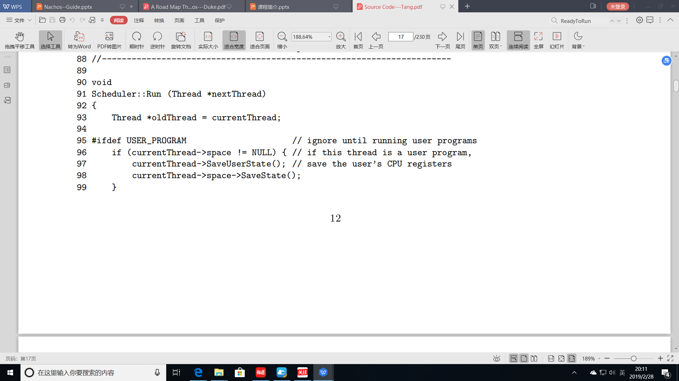
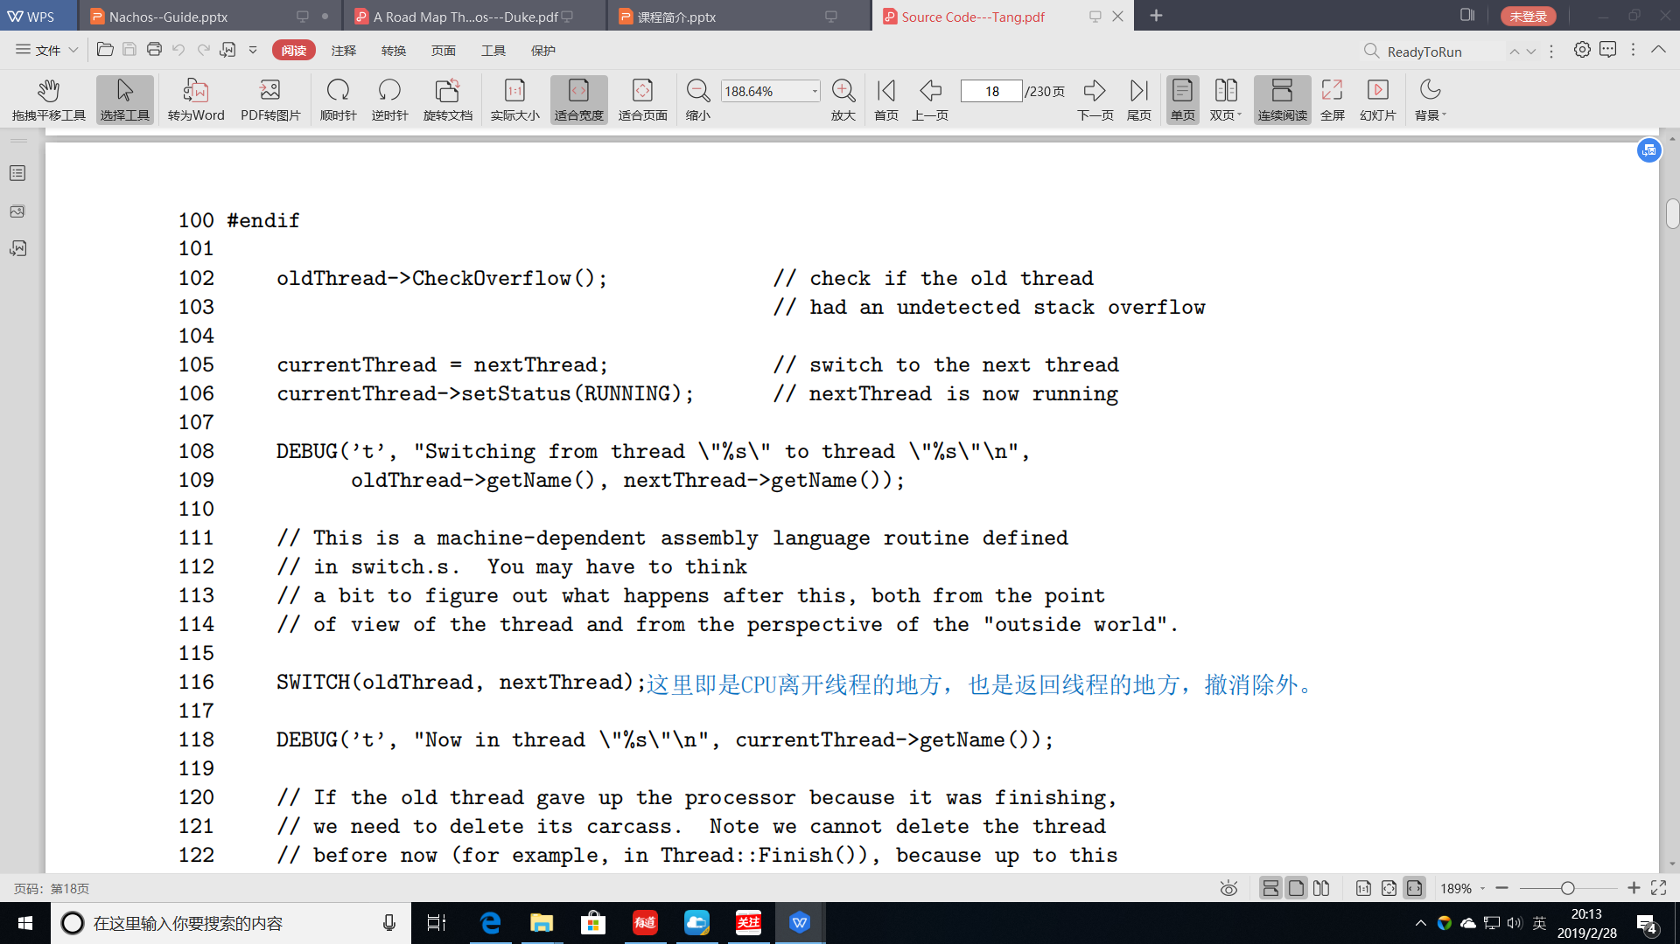
Run()

Slide 77
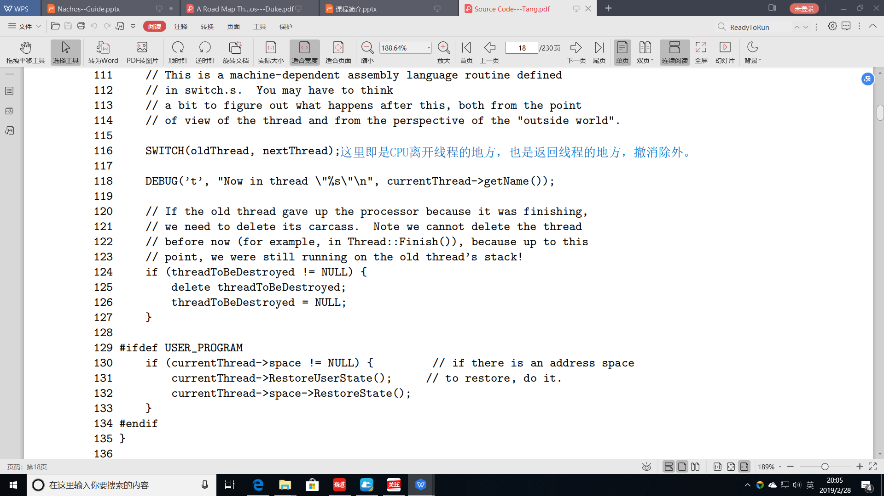
Run()

Slide 78
3. Nachos Threads
3.0 Basic concepts
3.1 Mechanics of Thread Switching
3.2 Threads & Scheduling
3.3 Synchronization and Mutual Exclusion
3.4 Special Notes

Slide 79
3.3 Synchronization and Mutual Exclusion
Low-level Nachos routines frequently disable and reenable interrupts to achieve mutual exclusion
e.g. by calling Interrupt::SetLevel()
Synchronization facilities are provided through semaphores
The Semaphore object provides the following operations
Semaphore(char *debugName, int initialValue)
The constructor creates a new counting semaphore having an initial value of initialValue
The string debugName is also associated with the semaphore to simplify debugging_x0002_
void P()
Decrement the semaphore's count(), blocking the caller if the count is zero
void V()
Increment the semaphore's count, releasing one thread if any are blocked waiting on the count

Slide 80
3.4 Special Notes
When Nachos first begins executing, it executs as a single Unix process
Nachos turns this single user process into a single Nachos thread
Nachos executes a single thread
When the Nachos entry routine main returns, that thread exits as well
However, if other threads have been created and continue to exist, the Unix process continues executing Nachos
Only after all threads have terminated does the Unix Nachos process exit

Slide 81
main()的返回
151......
152 currentThread->Finish(); // NOTE: if the procedure "main"
153 // returns, then the program "nachos"
154 // will exit (as any other normal program
155 // would). But there may be other
156 // threads on the ready list. We switch
157 // to those threads by saying that the
158 // "main" thread is finished, preventing
159 // it from returning.
160 return(0); // Not reached...
161 }

Slide 82
3. Nachos Threads
3.0 Basic concepts
3.1 Mechanics of Thread Switching
3.2 Threads & Scheduling
3.3 Synchronization and Mutual Exclusion
3.4 Special Notes
3.5 Controlling the Order of Execution in Nachos

Slide 83
3.5 Controlling the Order of Execution in Nachos
Many bugs in concurrent code are dependent on the order
Sometimes the program will run fine
other times it will crash
The exact interleaving may depend on all factors beyond your control
The OS scheduling policies
The exact timing of external events, and the phases of the moon
how to test your code and make sure that it is solid
3.5.1 Context Switches
3.5.2 Voluntary Context Switches
3.5.3 Involuntary Context Switches

Slide 84
3.5.1 Context Switches
On a multiprocessor
The executions of threads may be arbitrarily interleaved
Proper synchronization is even more important
In Nachos
Is uniprocessor-based interleavings are determined by the timing of context switches from one thread to another
Properly Synchronized
Exhaustively forces all possible interleavings to occur
Control when the executing program makes context switches
To experiment with different interleavings
Context Switches
Voluntary context switches
Involuntary context switches

Slide 85
Voluntary or Involuntary ?
Voluntary context switches
Reasons
The thread explicitly calls Thread::Yield
have to give up, such as block
Initiate
The thread itself
Running in the Nachos kernel
Involuntary context switches
Reasons, have no thing to with the thread itself
quantum expired
priority
etc.
Initiate
interrupt handler
this might happen when a timer interrupt signals that the current thread is hogging the CPU

Slide 86
3.5.2 Voluntary Context Switches
Control context switches
Pepper the code with voluntary context
Explicitly calling Thread::Yield at various interesting points
This emulate an involuntary context switch via a timer interrupt
Concurrent code should run correctly no matter where the yields to occur
Some code that absolutely cannot tolerate an unplanned context switch
e.g., the context switch code itself
This code protects itself by calling a low-level primitive to disable timer interrupts
Reentry
How about your code?

Slide 87
3.5.3 Involuntary Context Switches
Nachos has a facility to causes involuntary context switches
To aid in testing
To occur in a repeatable but unpredictable way
The -rs command line flag causes Nachos to call Thread::Yield at semi-random times
The exact interleaving of threads
Is determined by the value of the "seed" passed to -rs
You see will be repeated if you run the program again with the same seed value
Using -rs with various argument values is an effective way to force different orderings to occur deterministically

Slide 88
Discussion on -rs flag
In theory, the -rs flag causes Nachos to decide whether or not to do a context switch after each and every instruction executes
The truth is that -rs won't help much, if at all, for the first few assignments
In fact, Nachos only makes these choices for instructions executing on the simulated machine
In the synchronization assignments, all of the code is executing within the Nachos "kernel"
Nachos may still interrupt kernel-mode threads "randomly" if -rs is used
But these interrupts can only occur at well-defined times
They can happen only when the code calls a routine to re-enable interrupts on the simulated machine
Many possibly damaging interleavings will unfortunately never be tested with -rs
If we suspect that your code has a concurrency race during the demo, we may ask you to run test programs with new strategically placed calls to Thread::Yield

Slide 89
Content
1. Introduction
2. Nachos Machine
3. Nachos Threads
4. User level process
5. Nachos Filesystem
6. Experience With Nachos Assignments

Slide 90
4. User Level Processes
4.0 Noff
4.1 Process Creation
4.2 Create a Noff Binary
4.3 System Calls and Exception Handling
4.4 Execution Trace of User-Level Process

Slide 91
4.0 Noff
Nachos can run any MIPS binary
Assuming that it only makes system calls that Nachos understands
Nachos requires that executables be in the simpler Noff format
In Unix a.out files are stored in “coff”format
Convert binaries of one format to the other
coff2noff
Noff format files consist of four parts
The Noff header, describes the contents of the rest of the file
Giving information about the program's instructions
Initialized variables
Uninitialized variables

Slide 92
Noff Header
noff Magic
the first four bytes of the file
For each of the remaining sections, include the following information
virtualAddr
What virtual address that segment begins at(normally zero)
inFileAddr
Pointer within the Noff file where that section actually begins_x0002_
size
The size (in bytes) of that segment

Slide 93
4. User Level Processes
4.0 Noff
4.1 Process Creation
4.2 Create a Noff Binary
4.3 System Calls and Exception Handling
4.4 Execution Trace of User-Level Process

Slide 94
4.1 Process Creation
Operations
Creating an address space
Allocating physical memory for the address space
Loading the contents of the executable into physical memory
initializing registers and address translation tables
Invoking machine::Run() to start execution
Run() simply turns on the MIPS machine having it enter an infinite loop
Executes instructions one at a time

Slide 95
Running Enviroment(singal process)
Stock Nachos assumes that only a single user program exists at a given time
no one else is using physical memory and simply zeros out all of physical memory
reads the binary into physical memory starting at location mainMemory
Initializes the address translation tables
Initialization of registers
PCReg(0) and NextPCReg(4)
Stackpointer to the largest virtual address of the process
Nachos assumes that execution of userprograms begins at the first instruction(e.g.,virtual address 0)

Slide 96
Process Switch
When support for multiple user processes has been added
User process switch
AddrSpace::SaveUserState(), to save address-space related state
AddrSpace::RestoreUserState()
The low-level thread switching routines do not know about
A new set of address translation tables needs to be loaded
when using virtual memory
when switching from one process to another

Slide 97
4. User Level Processes
4.0 Noff
4.1 Process Creation
4.2 Create a Noff Binary
4.3 System Calls and Exception Handling
4.4 Execution Trace of User-Level Process

Slide 98
4.2 Create a Noff Binary
Nachos is capable of executing a program containing arbitrary MIPS instructions
For examples C programs in the test directory are compiled using gcc on a MIPS machine to create “.o” files
In a.out, the loader prepends the instructions in test/start.s before the code of the user program
File start.s contains initialization code that needs to be executed before the user's main program
The very first instruction in start.s calls the user-supplied main routine
The second instruction invokes the Nachos Exit system call insuring that user processes terminate properly when their main program returns.

Slide 99
4. User Level Processes
4.0 Noff
4.1 Process Creation
4.2 Create a Noff Binary
4.3 System Calls and Exception Handling
4.4 Execution Trace of User-Level Process

Slide 100
4.3 System Calls and Exception Handling
Syscall instruction
User programs execute the MIPS syscall instruction which generates a hardware trap into the Nachos kernel
Doesn't indicate which system call to perform
The code indicating the system call in register r2, parameters in r4-r7
RaiseException()
The Nachos MIPS simulator implements traps by invoking the Routine RaiseException() passing it a arguments indicating the exact cause of the trap
ExceptionHandler(which)
RaiseException() in turn calls ExceptionHandler to take care of the specific problem
Function (and system call) return values are in register r on return
User-level processes execute in their own private address spaces, which the kernel cannot reference
Use ReadMem and WriteMem to dereference pointers (as arguments) to system calls

Slide 101
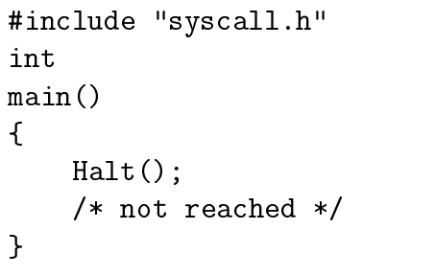
系统调用的例子

Slide 102
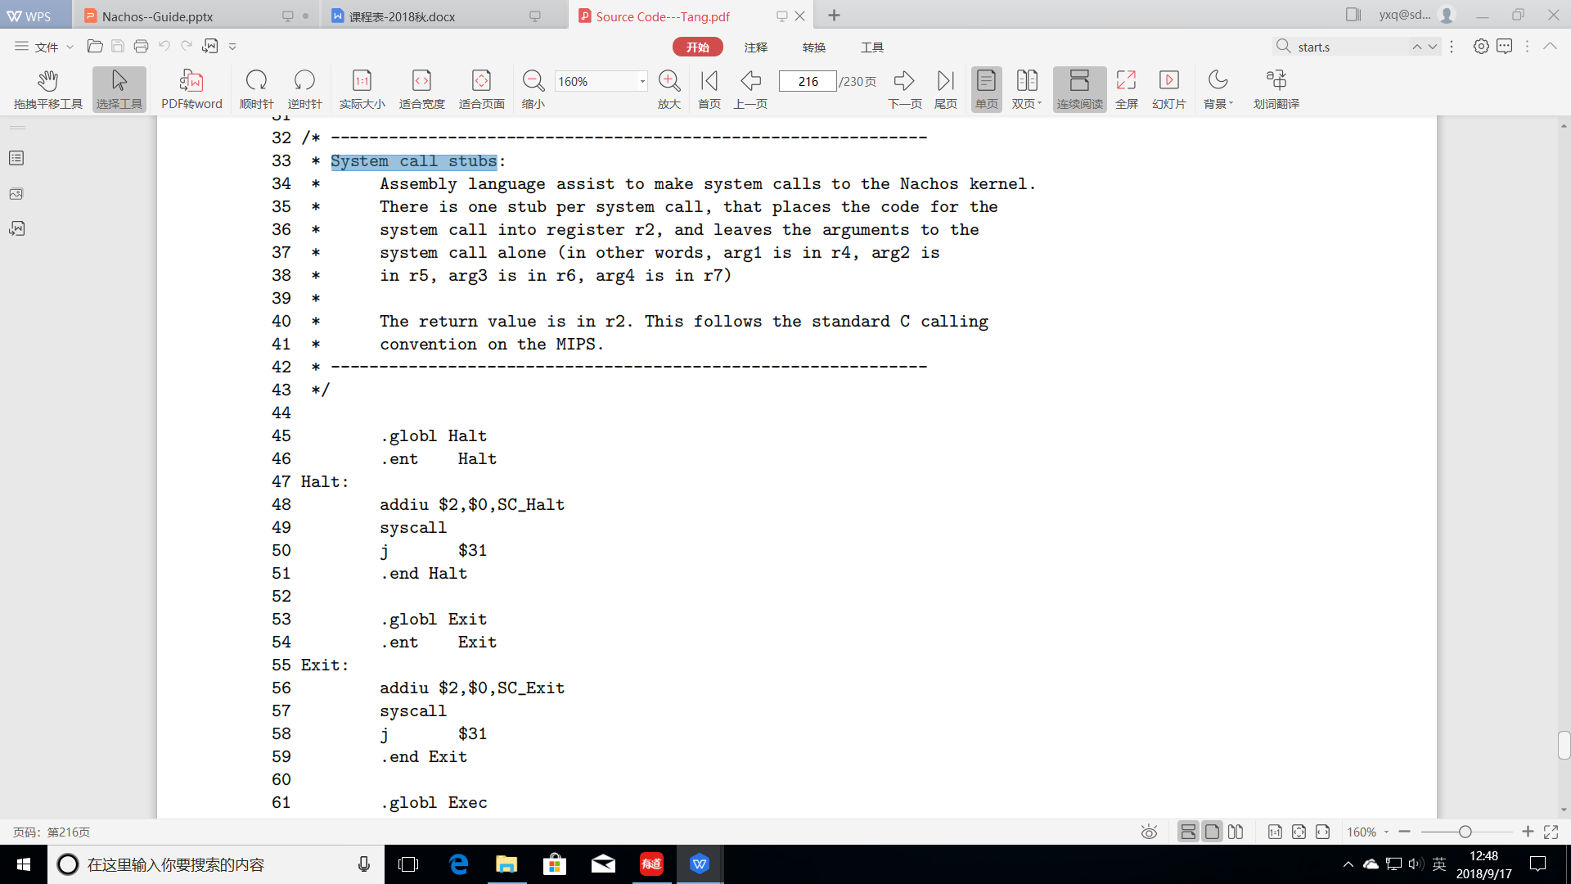
进入系统调用的桩

Slide 103
4. User Level Processes
4.0 Noff
4.1 Process Creation
4.2 Create a Noff Binary
4.3 System Calls and Exception Handling
4.4 Execution Trace of User-Level Process

Slide 104
4.4 Execution Trace of User-Level Process
The simplest Nachos program halt.c
When compiled, gcc -S generates the assembly language code, see next page
27 jal Halt
Invoking the halt system call
The code for Halt can be found in the file start.s
Starting a call
22 sub $sp, $sp, 24 # SP <== SP-24 (allocate space on stack)
23 sw $31, 20($sp) # Save return address on stack
24 sw $fp, 16($sp) # Update fp(将上一个栈帧的fp保存在当前栈帧中)
25 move fp, sp #设置当前栈帧的fp
Ending a call
29 move sp, fp # fp ==> sp，sp中的内容可能已经被破坏了
30 lw $31, 20(sp) # restore return address to $31
31 lw $fp, 16(sp) # restore fp of last stack frame
32 addu $sp, $sp, 24 # restore sp of last stack frame
33 j $31 # 主程序返回，进程结束

Slide 105
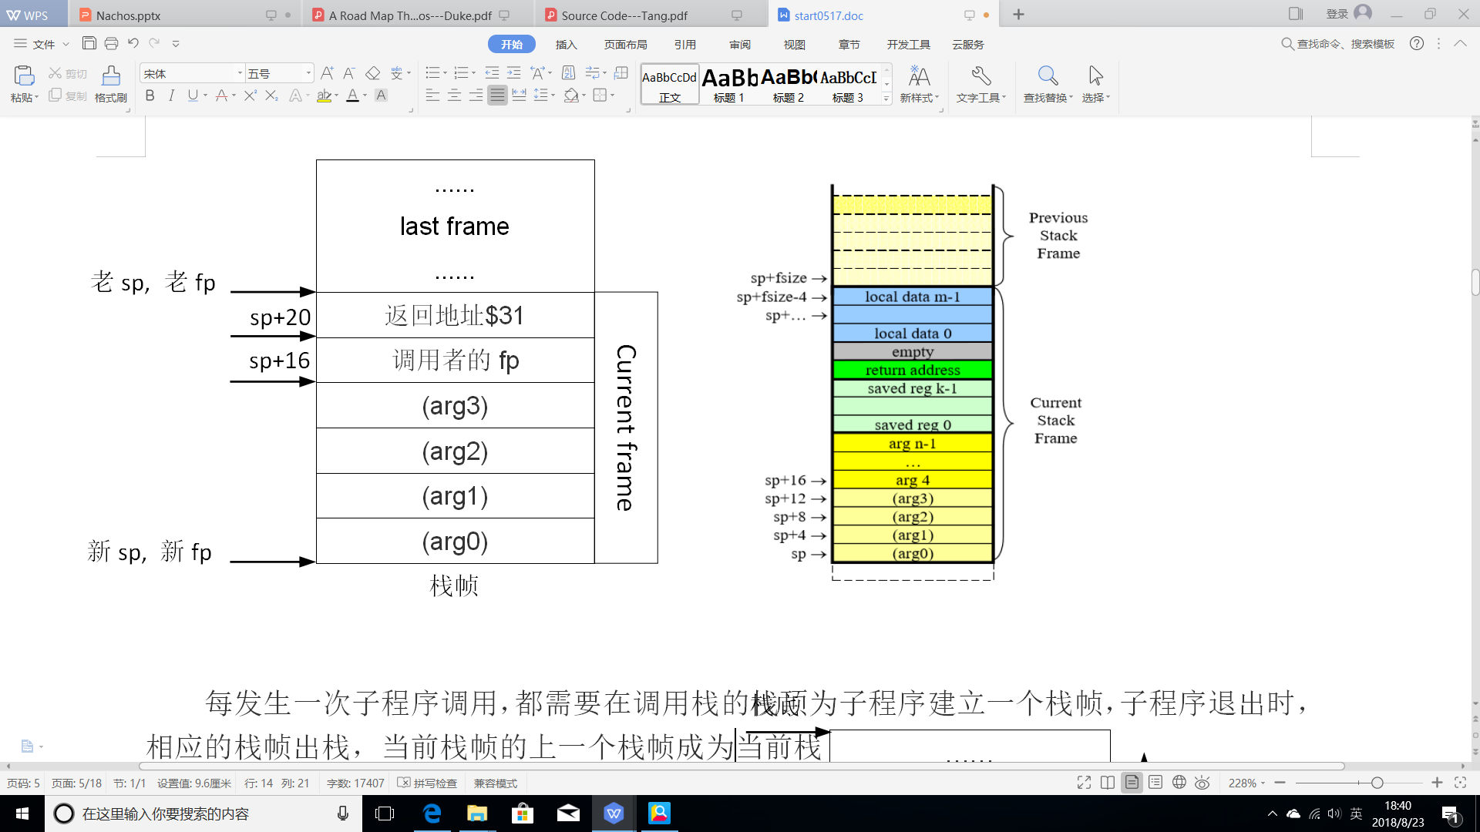
栈帧 Stack Frame

Slide 106
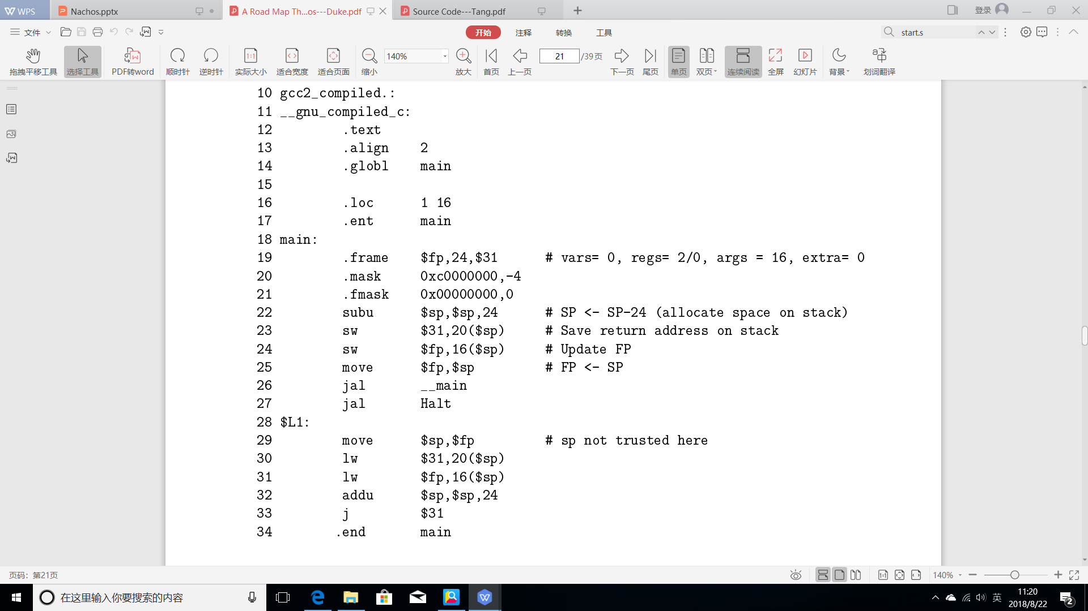
halt.c 的汇编代码
栈帧指针

Slide 107
用户程序的启动和结束
程序启动
The first actual instruction simply calls the procedure main
进入用户程序main开始执行
halt.c中的程序
退出
Tell Nachos we are done via the exit() system call
封装

Slide 108
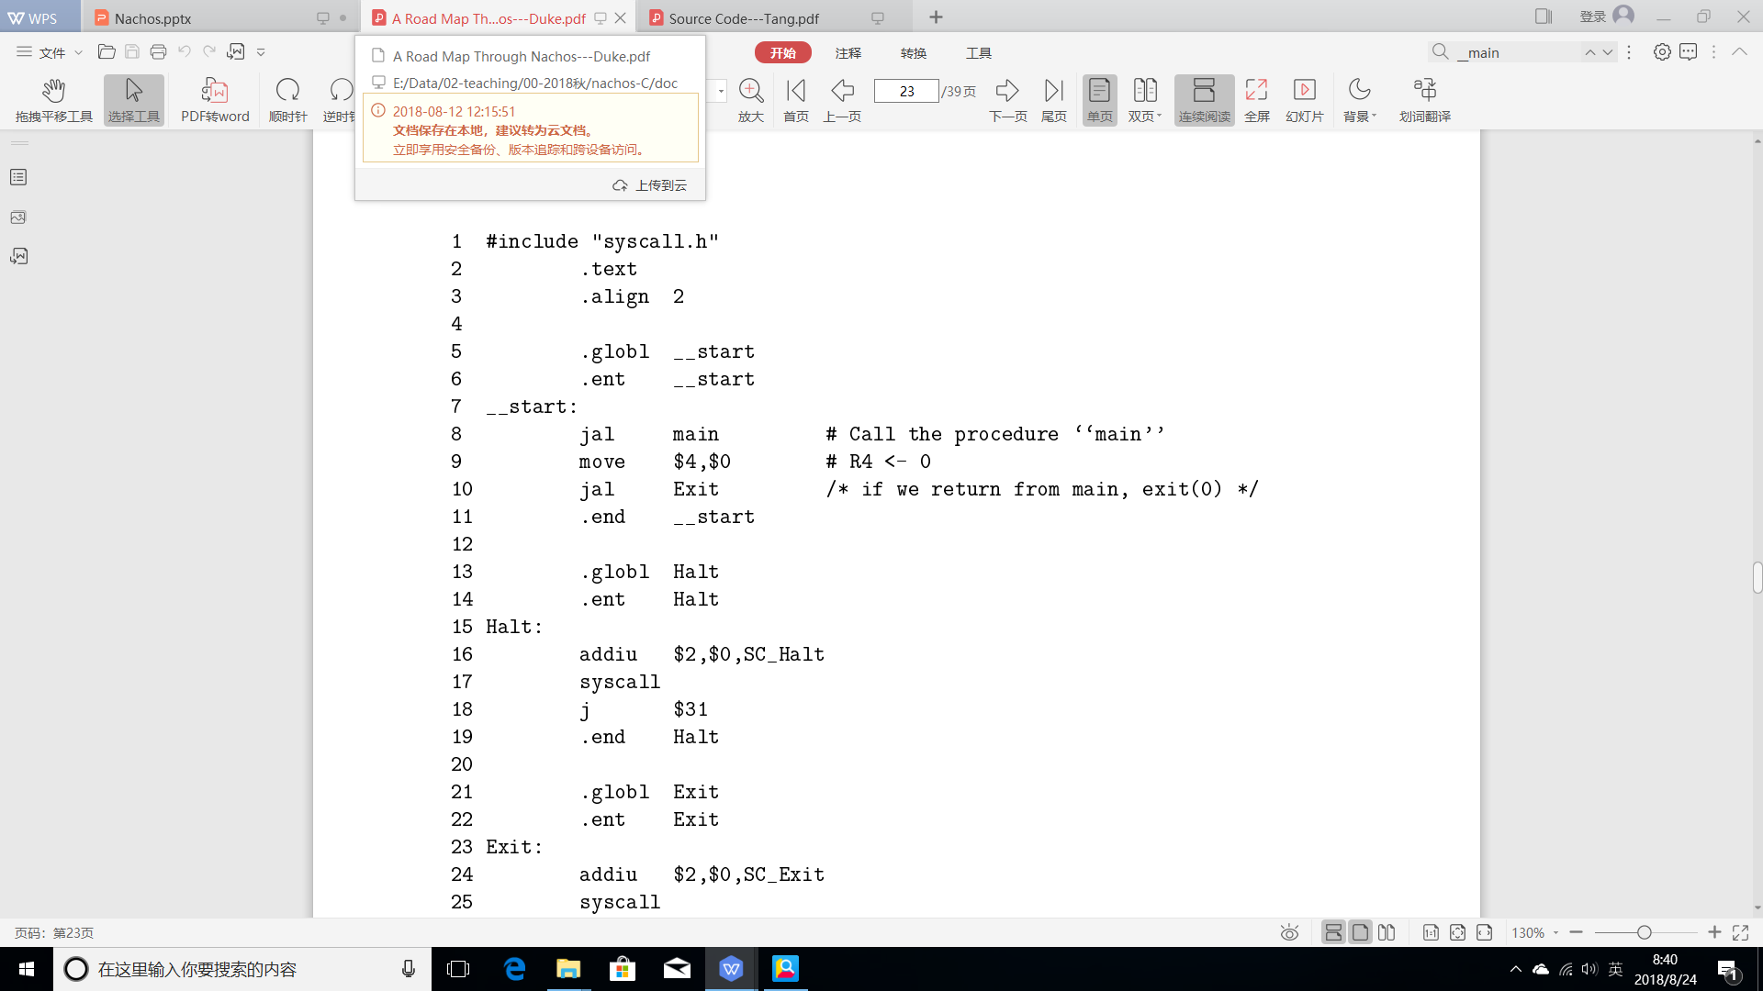
用户程序的启动 __start

Slide 109
System Call
System calls 的调用
Placing a code for the system call in register 2
Executing the syscall machine instruction
The syscall instruction is a trap instruction
The next instruction will be the first instruction of the trap handler
Exit()
执行退出的系统调用一般是不会返回的
syscall之后的j $31只是个摆设
start.s是和halt.c一起编译（汇编）的
代替了C的标准函数库
Halt()不是系统调用（System call stubs）

Slide 110
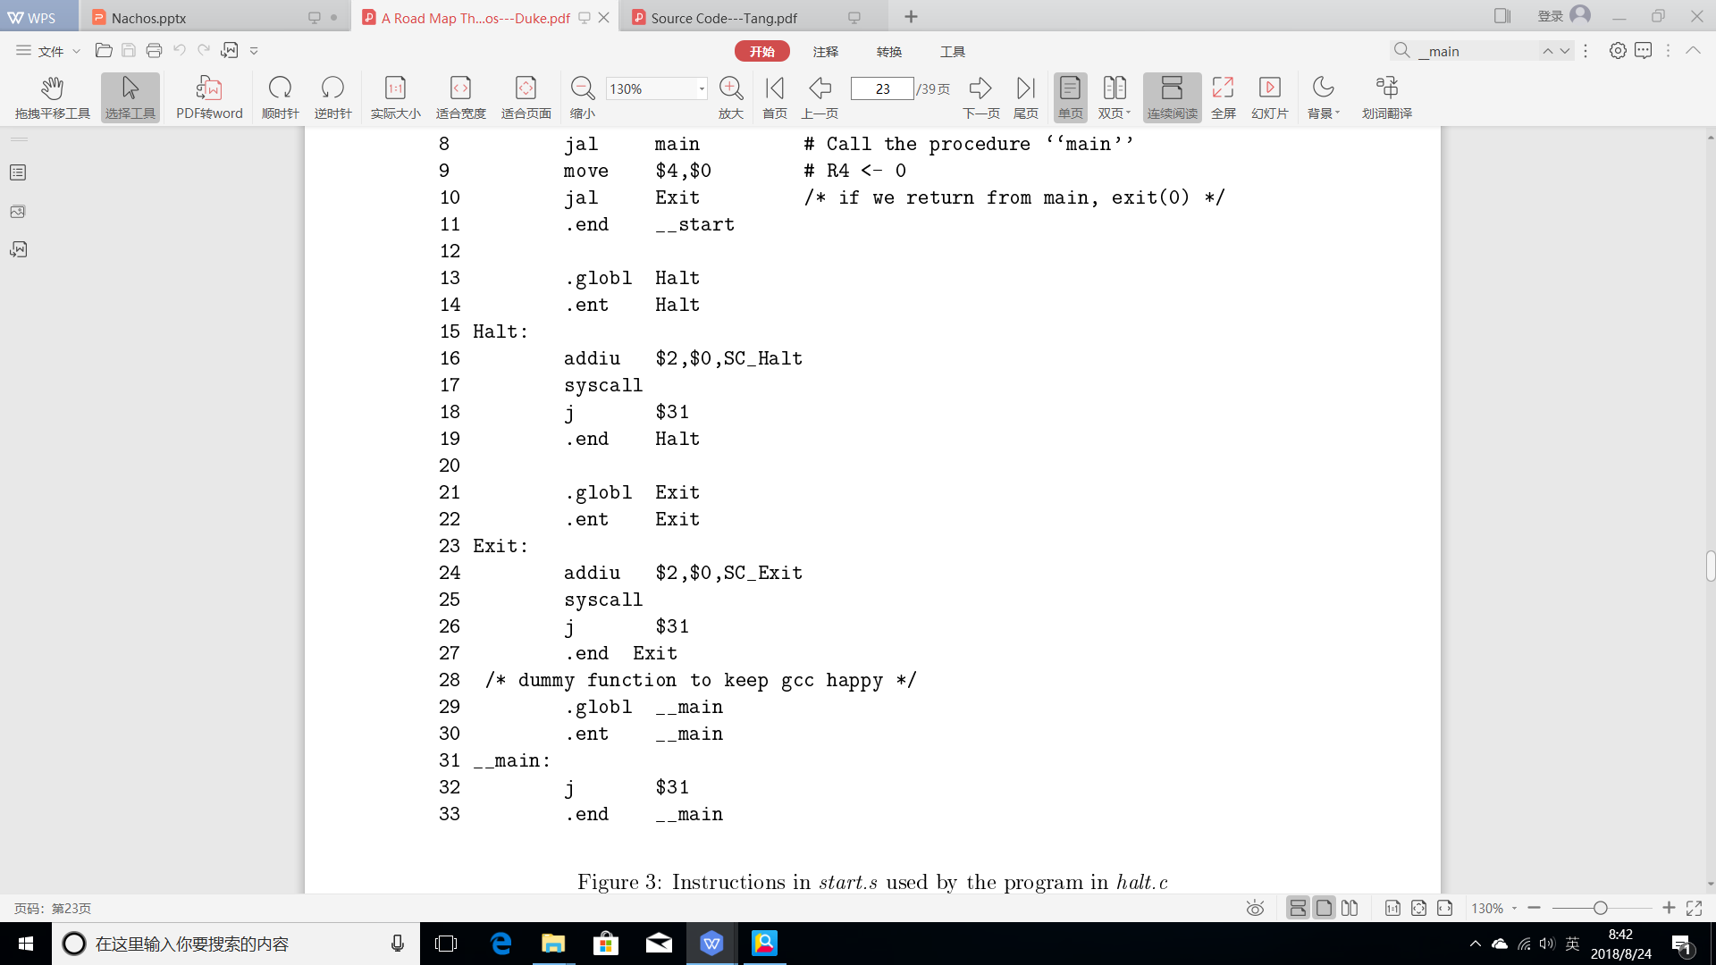
System Call-- Exit()
摆设

Slide 111
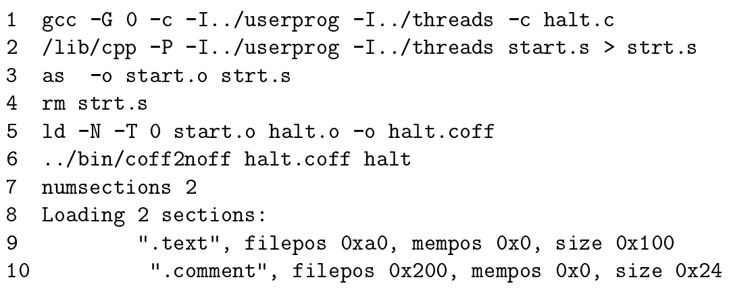
编译halt.c和start.s

Slide 112
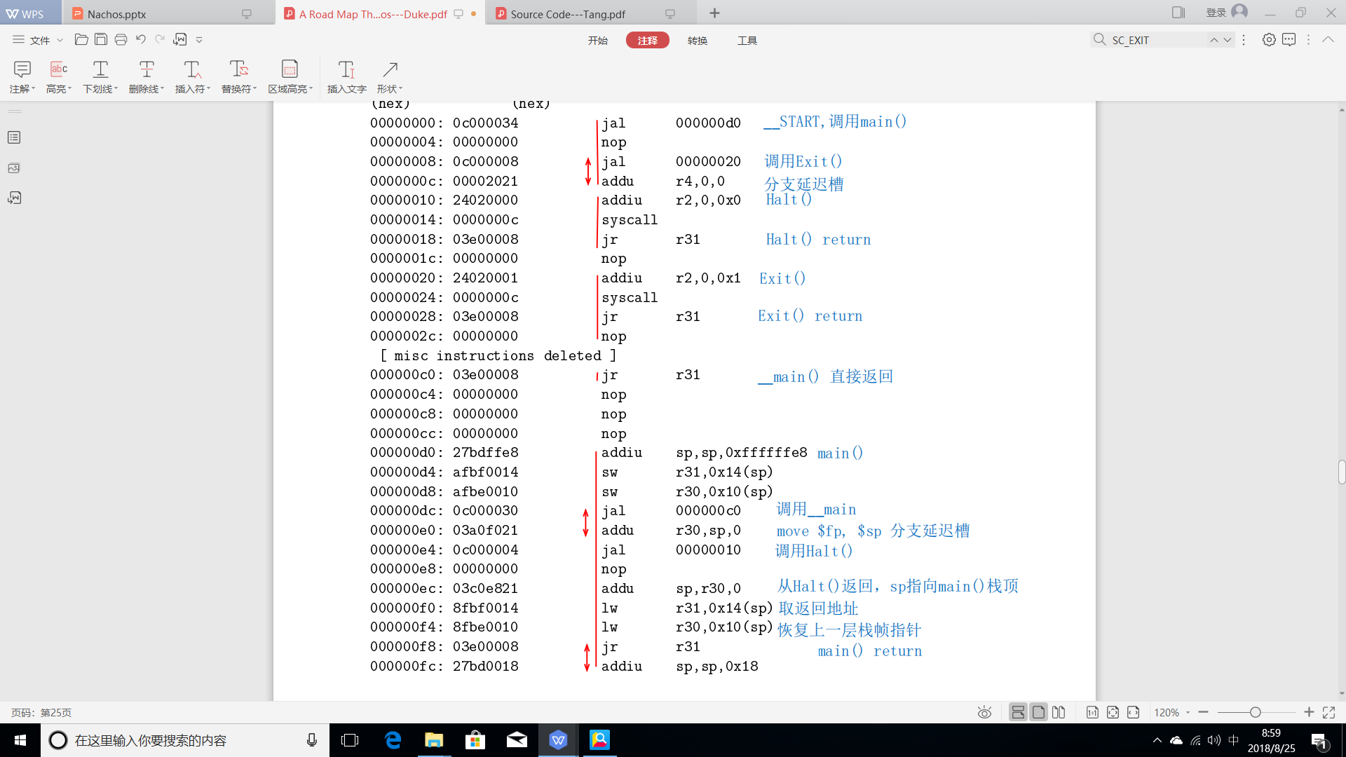
halt程序的反汇编结果
地址 指令码 指令 注释

Slide 113
halt程序的反汇编结果(cont.)
地址 指令码 指令 注释

Slide 114
Content
1. Introduction
2. Nachos Machine
3. Nachos Threads
4. User level process
5 Nachos Filesystem
6. Experience With Nachos Assignments

Slide 115
5 Nachos Filesystem
5.0 Overview
5.1 SynchDisk Object
5.2 FileSystem Object
5.3 OpenFile Object
5.4 File System Physical Representation

Slide 116
5.0 Overview
Two versions of the Nachos file system
Based on Unix
Based on a raw disk
Both file systems provide the same service and interface
-DFILESYS STUB compilation flag controls which version gets used
Based on Unix
A front-end to the Unix file system
Users can access files within Nachos without having to write their own file system
Based on a raw disk
Implement a file system on top of a raw disk
A regular Unix file
Can be accessed through a simulated disk
The simulated disk accesses the underlying Unix file exclusively
read/write individual sectors

Slide 117
Objects in File System
Files are accessed through several layers of objects
Disk object
Provides a crude interface for initiating I/O operations for individual sectors
SynchDisk object
Provides synchronized access to a Disk
Blocking callers until a requested operation actually completes
Allows multiple threads to safely invoke disk operations concurrently
Mutual exclusion
FileSystem object
Creating/Deleting/Opening/Closing
OpenFile object
seeks/reads/writes
A file descriptor returned from FileSystem's Open routine

Slide 118
5.1 SynchDisk Object
SynchDisk(char name)
Constructs the disk from Unix file “DISK”
Called once at system boot time
Can be accessed through the global variable synchDisk
RequestDone()
Interrupt service routine, called by the underlying Disk object when an I/O operation completes
Simply issues the semaphore V operation
ReadSector(int sectorNumber, char *data)
Acquire a mutual exclusion lock
Invoke the underlying Disk::ReadSector operation
Wait on the semaphore that RequestDone signals when the I/O operation completes
WriteSector(int sectorNumber, char data)
Acquire a mutual exclusion lock
Invoke the underlying Disk::WriteSector operation
Wait on the semaphore that RequestDone signals when the I/O operation complete

Slide 119
5.2 FileSystem Object
FileSystem(bool format)
For the stub system, this constructor does nothing._x0013_ the Unix file system is used instead, For the Nachos fil system format
format indicates whether FileSystem should be re-initialized or retained_x0002_
Is called once at boot time, after a synchDisk instance
bool Create(char name, int initialSize)
Creates a zero length file called name
If the file already exists,truncates its contents
Does not actual open a file
initialSize specifies the actual size of the file
For the stub system, it is ignored

Slide 120
FileSystem Object (cont.)
OpenFile *Open(char *name)
Opens file name for subsequent read or write access
Note that all files opened under Nachos are opened with both read and write access
Nachos is unable to Exec binary _x0014_les that are not writable because
The difference between Open and create
bool Remove(char *name)
Deletes file name and frees the disk blocks associated with that file
Note that in Unix, the disk sectors associated with a deleted file are not actually returned to the free list as long as there are any processes that still have the file open
One suggested Nachos assignment is to provide Unix style deletion

Slide 121
5.3 OpenFile Object
Each OpenFile object has a track of read or write operation ended
OpenFile(int sector)
sector is contained in the FileHeader for the file
A FileHeader is similar to a Unix inode
OpenFile returns a pointer to an OpenFile object
int ReadAt(char *into, int numBytes, int position)
copies numBytes of data at position into the buffer into,
int Read(char *into, int numBytes)
invokes ReadAt, passing it the current read/write mark
int WriteAt(char from, int numBytes, int position)
int Write(char from, int numBytes)
int Length()
Returns the actual size of the file

Slide 122
5.4 File System Physical Representation
5.4.1 File Header
5.4.2 Directories
5.4.3 Putting It All Together

Slide 123
5.4.1 File Header
FileHeader contains all the essential information about a file
The file's current size
Pointers to its physical disk blocks
A Nachos' FileHeader contains
The current size of the file in bytes
The number of sectors that have been allocated to the file
An array of sector numbers identifying where the file's data blocks
The size of the File
At file creation time, Nachos allocates enough sectors to match the file
Thus, as data is appended to the file, no sectors need ngful data
Limiting the maximum size of a Nachos file to just under 4K bytes
A FileHeader fits into a single sector
fnode is used to refer to a sector that contains a FileHeader

Slide 124
FileHeader Operations
bool Allocate(BitMap *bitMap, int fileSize)
Find and allocate enough free sectors for fileSize bytes of data
bitMap is the bit map from which data blocks are to be allocated
void Deallocate(BitMap *bitMap)
void FetchFrom(int sectorNumber)
Read the FileHeader stored in sector sectorNumber from the underlying disk
void WriteBack(int sectorNumber)
int FileLength()
int ByteToSector(int offset)
Map the offset in a file into the sector number that contains that data byte

Slide 125
5.4.2 Directories
Nachos supports a single top-level directory managed by the Directory object
When a file is created, it is added to the directory
Likewise, deleting a file results in its removal from the directory
Directory entries
filename
fnode
free_flag
Indicating whether that directory slot is currently allocated

Slide 126
Directory Operations
Directory(int size)
void FetchFrom(OpenFile file)
void WriteBack(OpenFile file)
int Find(char *name)
bool Add(char *name, int newSector)
Add the file name with fnode newSector to the directory
This routine only updates the in-memory copy of the directory
To make the directory changes permanent, WriteBack must subsequently be invoked
bool Remove(char *name)
List()
Print()

Slide 127
5.4.3 Putting It All Together
The list of free sectors and the top-level directory are Nachos files_x0002_
The free list is stored in a file with fnode 0
The top-level directory is stored in a file with fnode 1
Finding a free sector in the filesystem requires
Reading the file associated with fnode 0
Using the bitmap functions to locate free sector(s)
Flushing the file changes back to disk
Updating the directory when creating a new file
Reading the file associated with fnode 1
Finding an unused directory entry
Initializing it
Writing the directory back out to disk

Slide 128
5.4.3 Putting It All Together (cont.)
When a file system is created
Initializes the free list and top-level directory
Opens the files containing the two main data structures
The contents of the free list and directory can be accessed via the
OpenFile *freeMapFile
OpenFile *directoryFile
修改后，flushing the files changes back to disk
When creating and modifying Nachos files, one must be careful to keep track of
What data structures are on disk
Which ones are in memory

Slide 129
5.4.3 Putting It All Together (cont.)
If one traces through the code for FileSystem::Create one sees that
All the allocations and updates are first made in memory
Without error the changes are made permanent by committing them to disk.
This approach greatly simplifies error recovery
The FileSystem code assumes that only a single thread accesses the filesystem at any one time
what will happen if more then one ..._x0002_
No attempt has been made to reduce disk latencies by clustering related blocks in adjacent sectors

Slide 130
Content
1. Introduction
2. Nachos Machine
3. Nachos Threads
4. User level process
5. Nachos Filesystem
6. Experience With Nachos Assignments

Slide 131
6. Experience With Nachos Assignments
6.1 General Tips
6.2 Synchronization
6.3 Multiprogramming
6.4 Virtual Memory
6.5 File System
6.6 Common Errors

Slide 132
6.1 General Tips
Use a debugger, force students to learn to use a debugger
Use of code browsing tools, greatly simplifes the reading and understanding of source code
Test programs well
The Nachos assignments included in the distribution are very general and leave out many details
Students have a tendency to try to solve the entire problem at once rather than one step at a time

Slide 133
6.2 Synchronization
Testing the correctness of the synchronization facilities is difficult
Because Nachos preempts threads only at well defined points
Many incorrect solutions tend to work on the simple test cases

Slide 134
7. A Little Thing for MIPS Architecture
A fact
A number of instructions(class A) that do not take effect right away
Some instructions(class B) takes long time to execute
Fetch values from memory, for example
During this time(T), another instruction can be excuted that doesn't access memory
Instructions(class A) are called delayed loads(延迟加载)
Time T is called load delay slot
That is, delayed loads are executed during load delay slot
The compiler
Can rearrange the order of instructions in order to fill the delay slot with useful instruction
For example, a value could be loaded a few instructions earlier than it is actually needed, as long as the target register was not being used

Slide 135
Examples
Tracing programs in Nachos
We should be aware that instructions used in calling subroutines have a one-instruction delay(fetch the instruction)
The code for calling the procedure Exit with an argument of 0 would be done as follows:
jal Exit # jump to procedure 'Exit'
addu r4, 0, 0 # r4 <= r0 + 0 (r0 always has a value of 0)
The instruction that zeroes out register r4 appears after the jal instruction, rather than before as expected
分支延迟槽 (Branch delay slot)
简单地说就是位于分支指令后面的一条指令，不管分支发生与否其总是被执行，而且位于分支延迟槽中的指令先于分支指令提交 (commit)

